Slide 1

Team Details
  Team name: ASM FinTech Developer
  Team leader name: Abhinav Mukwane
  Problem Statement: Financial Health Score

Slide 2
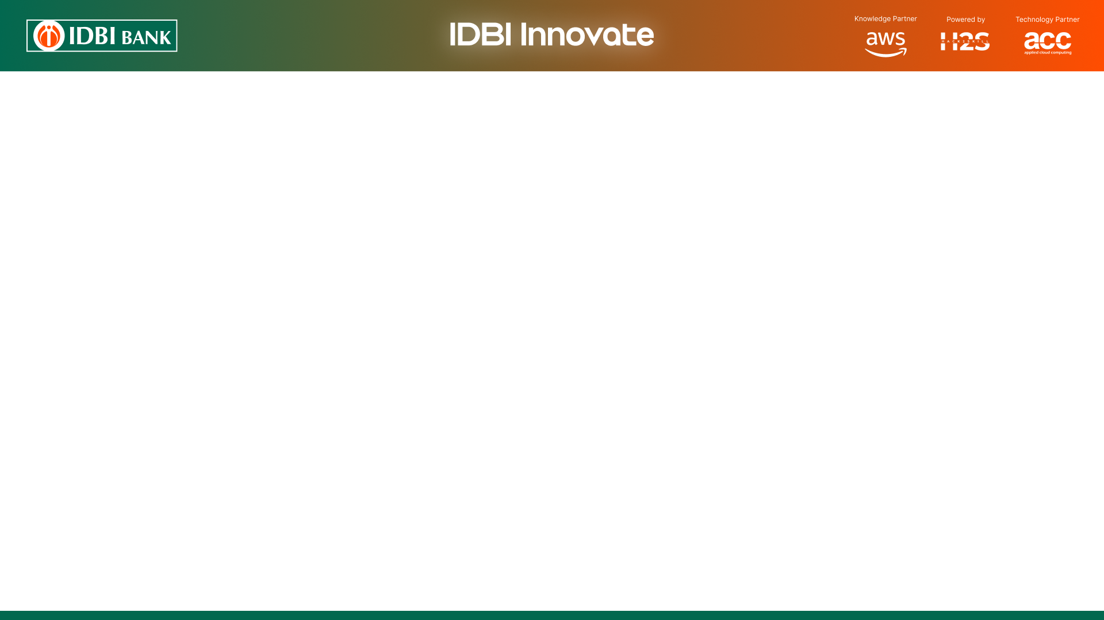
Brief about the idea
India has 64 million MSMEs contributing ~30% of GDP, yet 80%+ lack formal credit access. New-to-Credit (NTC) and New-to-Bank (NTB) enterprises are routinely rejected despite genuine creditworthiness — simply due to missing paperwork.
FinRiskLensAI : AI-Powered MSME Financial Health Score Platform
Aggregates alternate data streams: GST returns, Account Aggregator (Account statements UPI & Other), ITR filings, Udyam registry , Ministry Corporate Affairs and Related director verification, IP Verification, (EPFO slot ready)
Computes a multi-dimensional Financial Health Score (0-1000) across 6 weighted pillars using ML.NET (LightGBM model + rules engine)
Generates a visual Financial Health Card with radar chart, trend graph, risk flags, and credit product recommendations
Integrates with ULI (DSP API), OCEN 2.0 (LSP interface), and AA FIU consent framework for near real-time assessment
Near real-time scoring: end-to-end score in under 10 seconds from consent trigger
PFI-based explainability: every score carries a dimension-level reason - audit-ready for credit officers
Recommends CGTMSE/MUDRA-backed products for mid-range scorers to maximise viable approvals
Enables IDBI Bank to on-board credit-invisible MSMEs while strengthening portfolio quality and sector diversification

Slide 3
Opportunities
How different is it from any of the other existing ideas?
Unlike CIBIL/Experian bureau scores, FinRiskLensAI works for NTC/NTB borrowers with zero credit history
Unlike single-source tools, we unify 6 DPI data streams (GST + AA + ITR + Udyam + MCA + DIN + IP) in consent-based flow
First solution combining ULI DSP-compatible API + OCEN 2.0 LSP + AA FIU consent flow in a single platform
GST vs. bank-credit cross-validation as a proprietary fraud signal — no existing tool does this
How will it be able to solve the problem?
Eliminates the 'no document, no credit' rejection cycle by using MSMEs' existing digital footprints as credit proxies
Near real-time scoring replaces 2-3 week manual evaluation with a sub-10-second automated assessment
PFI explainability gives credit officers dimension-level reasons — no black-box decisions
Neutral baseline for NTC status prevents unfair penalization of first-time borrowers
USP of the proposed solution
6-dimensional score gives IDBI a far richer risk picture than any single metric (Revenue, Cash Flow, Transactions, Compliance, Stability, Debt)
Built entirely on India's DPI stack — zero proprietary data dependency, fully consent-based and DPDP Act 2023 compliant
Credit product recommender maps score band to CGTMSE/MUDRA schemes — maximizing both approval rate and safety
ULI DSP-compatible API means any OCEN-compliant lender can plug in — IDBI's infrastructure becomes reusable fintech rails

Slide 4
List of features offered by the solution
Data Aggregation
Consent-based multi-source pull: Udyam registry, GST API (GSTR-1/2A/2B/3B, ITC), ITR filings, AA bank & UPI statements (EPFO slot ready)
GST vs. bank-credit cross-validation for fraud/misrepresentation detection
AI / ML Scoring Engine
6-Dimension Weighted Score (0-1000): Revenue Vitality (25%), Cash Flow Health (20%), Tx Trustworthiness (15%), Compliance (15%), Business Stability (15%), Debt Serviceability (10%)
ML.NET LightGBM for tabular scoring + SSA time-series for 12-month trend + RandomizedPCA for cross-source anomaly detection
PFI (Permutation Feature Importance): per-dimension reasons for every score - audit-ready
Financial Health Card UI
Radar/spider chart for 6 dimensions, 12-month trend graph, green/yellow/red risk flags, top 3 strengths and risks
Recommended credit products (CGTMSE, MUDRA, standard working capital) mapped to score band
Downloadable PDF Health Card for branch-level use by IDBI credit officers
Integration & API
ULI DSP-compatible REST API: any OCEN-compliant lender queries the score with mTLS + OAuth2
IDBI LOS Integration: score + Health Card delivered inline to Loan Origination System
AA FIU consent lifecycle: consent request, artefact verification, FIP data pull, auto-expiry
On-demand refresh: a new GST filing or AA consent re-runs the blob-based scoring pipeline

Slide 5
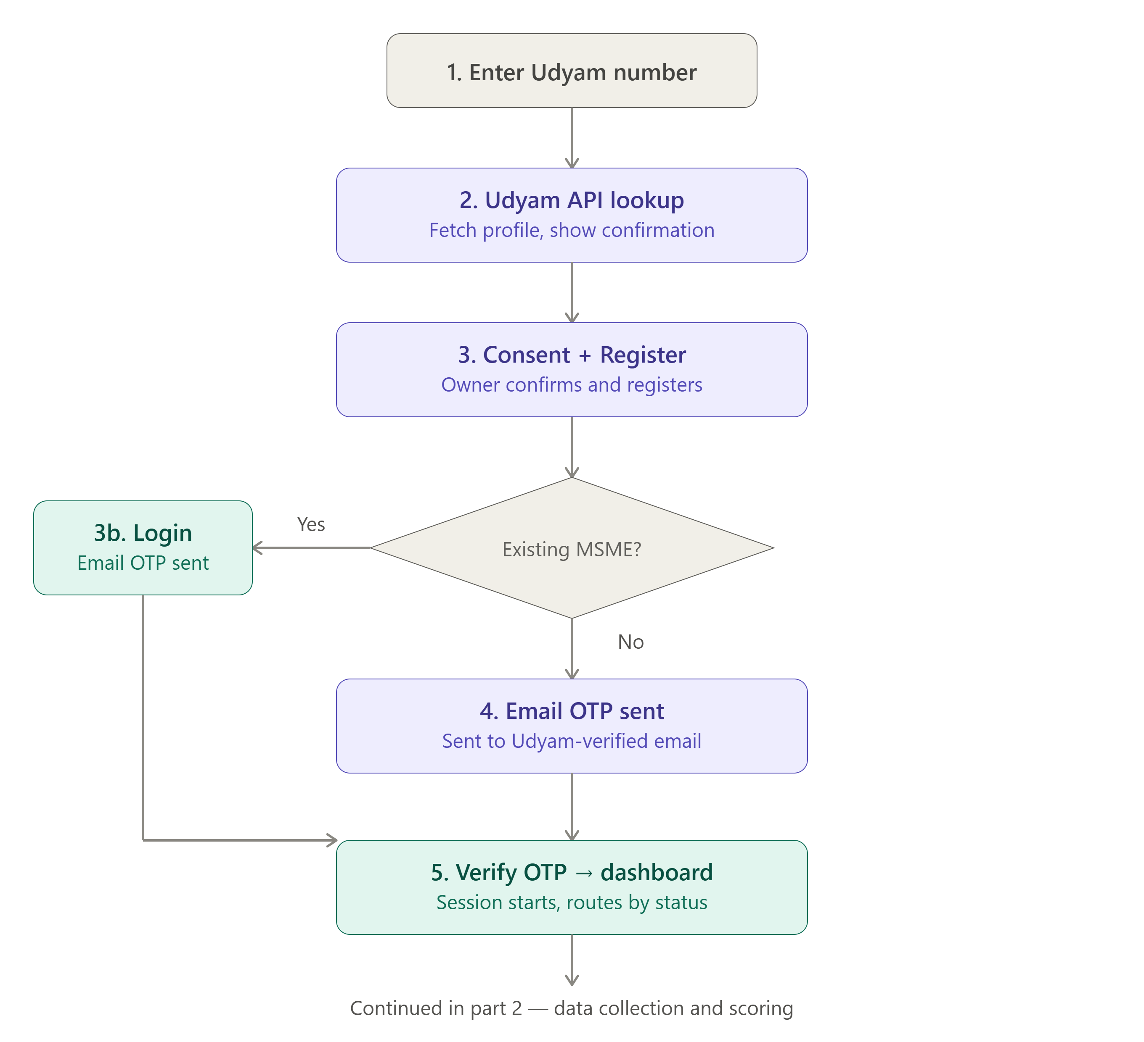
Process flow diagram or Use-case diagram

Slide 6
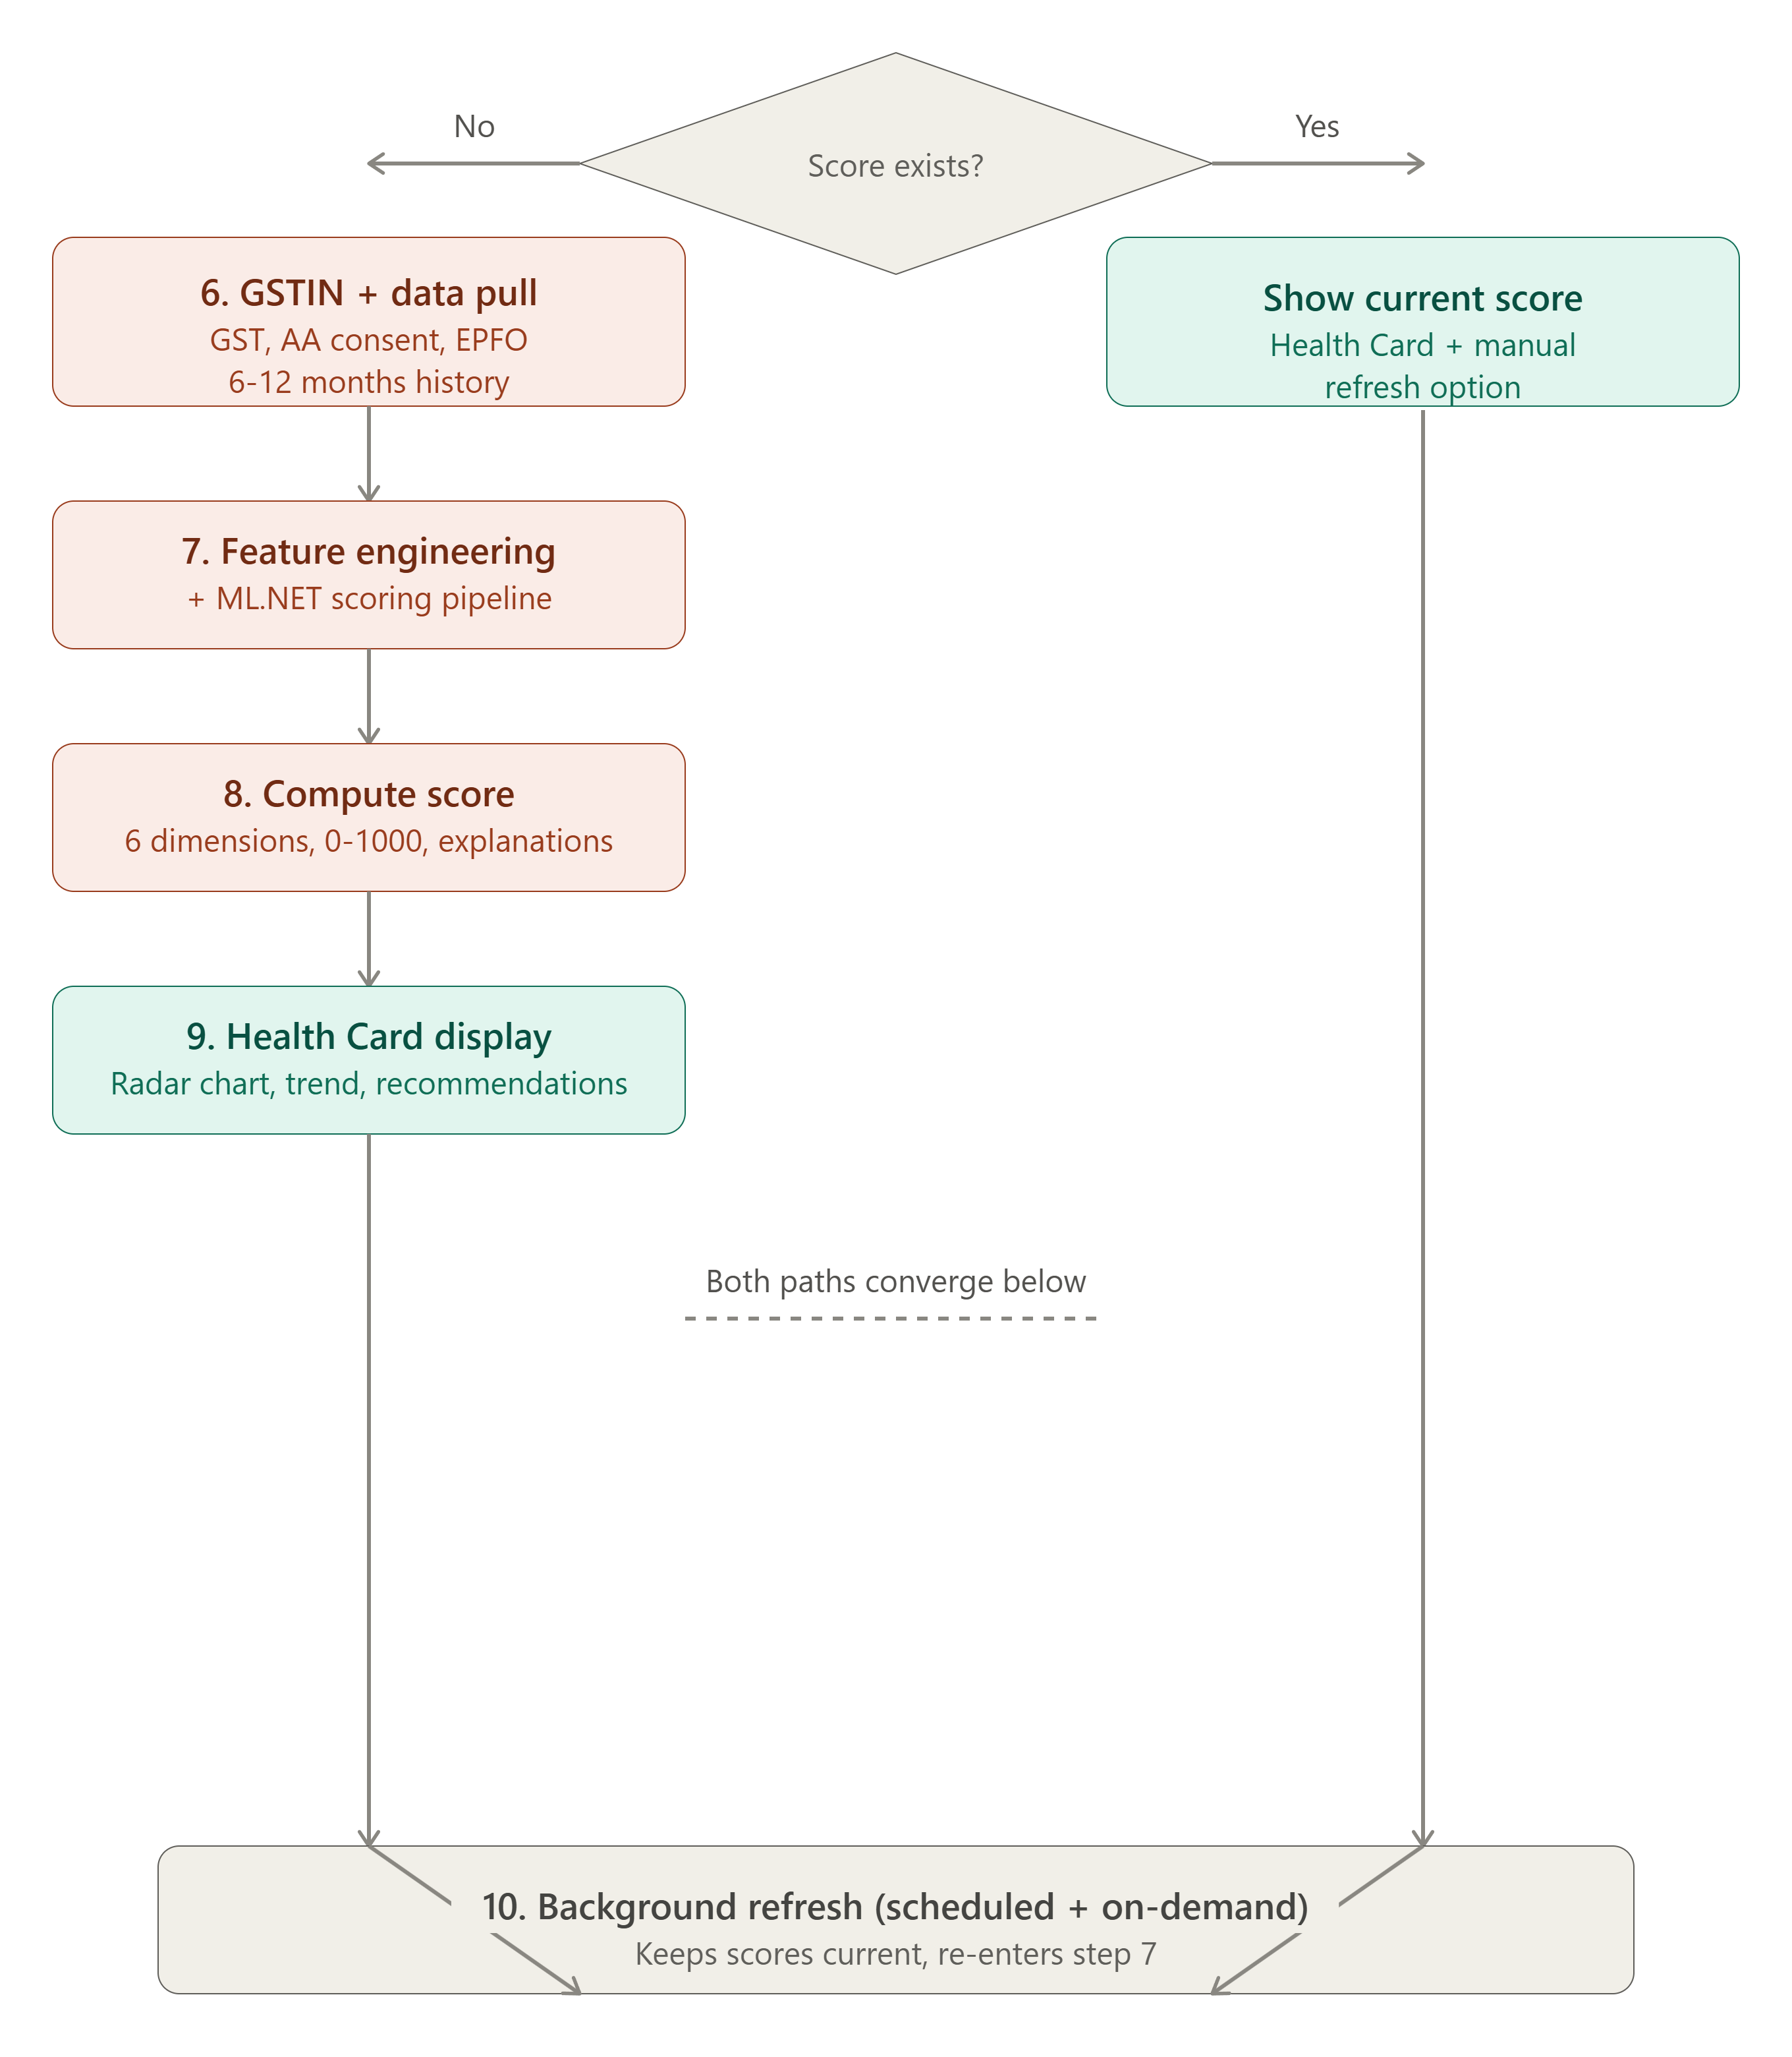
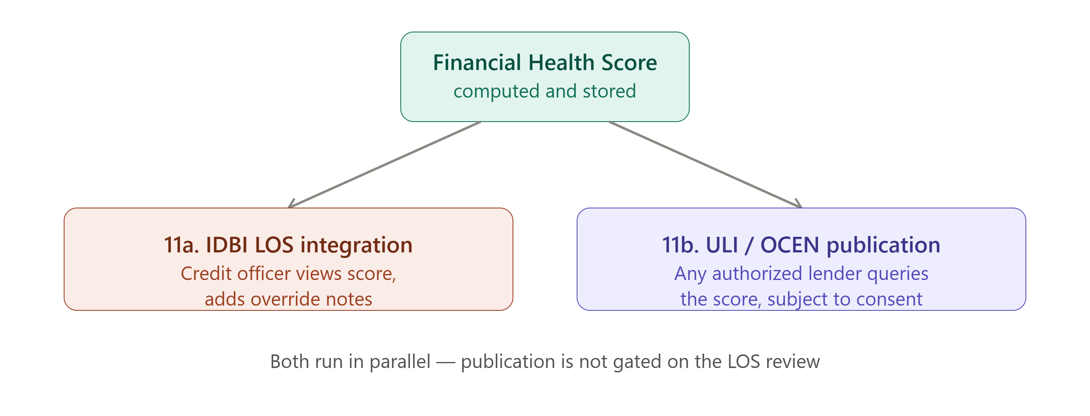
Process flow diagram or Use-case diagram

Slide 7
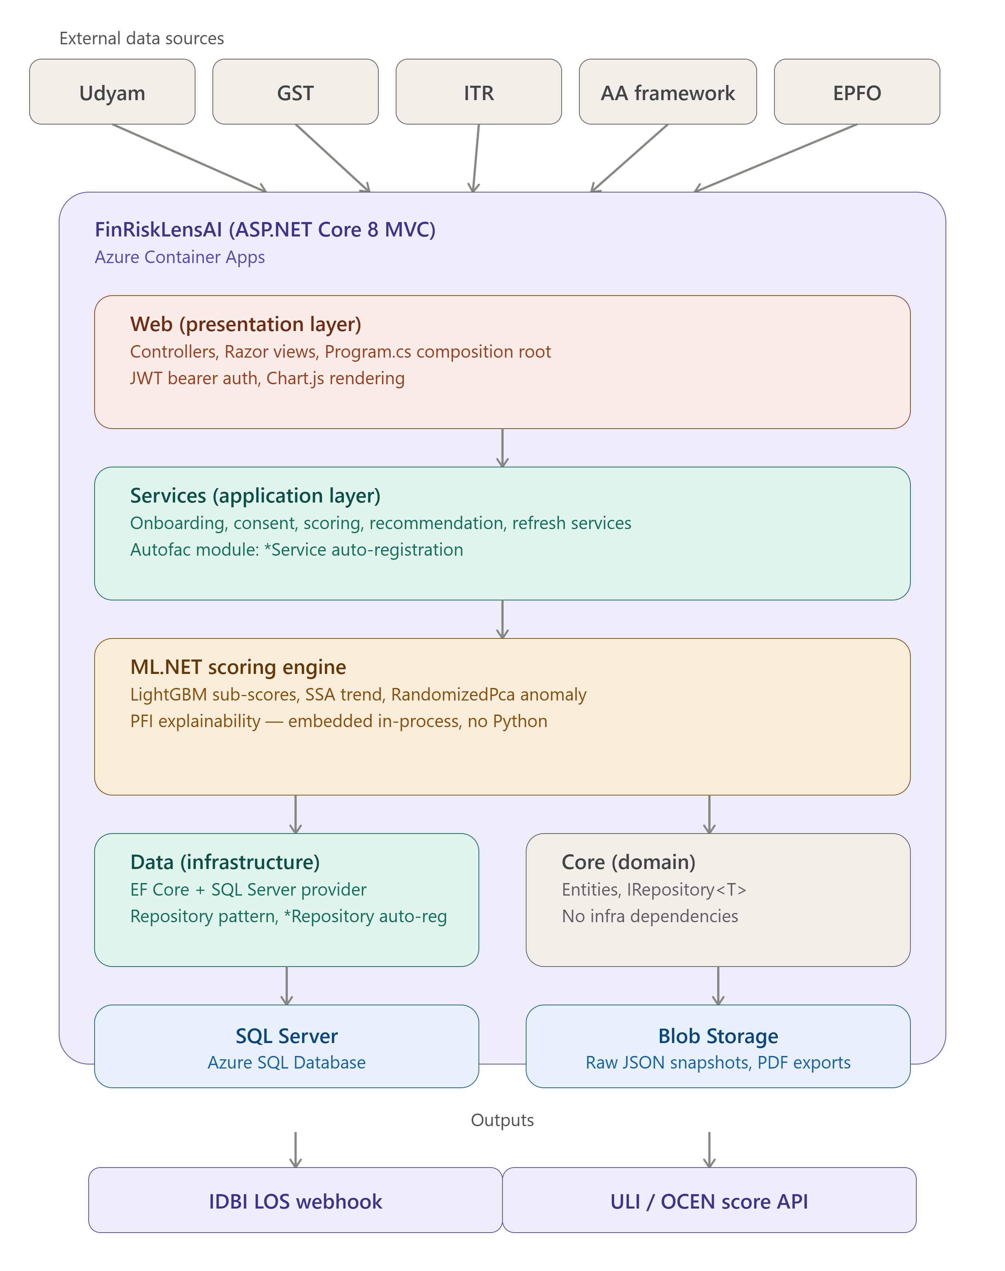
Architecture diagram of the proposed solution

Slide 8
Technologies to be used in the solution
Backend — Orchestration & API
ASP.NET Core 8 MVC (C#): orchestration + Udyam/GST/ITR/AA (Finvu) connectors, ULI DSP, IDBI LOS webhook
ML.NET (in-process): scoring, feature engineering & PFI explainability - no separate ML service
Autofac: DI & module auto-registration | Serilog: structured file/console logging
AI / ML Stack
ML.NET LightGBM: calibration model; final score = 0.6 rules engine + 0.4 ML model
ML.NET SSA (Singular Spectrum Analysis): 12-month cashflow / revenue trend
Permutation Feature Importance (PFI): per-dimension, audit-ready explanations
ML.NET RandomizedPCA: 3-way GST vs ITR vs bank-credit anomaly / fraud signal
Data & Storage
SQL Server + EF Core 8: MSME profiles, consent & OTP tables, audit trail (code-first migrations)
Azure Blob Storage: per-MSME data folder (raw source JSON + result.json)
Infrastructure & DevOps
Single ASP.NET Core 8 web app - Web + ML.NET in one deployable (modern monolith Architecture)
Azure API Management (planned): ULI/OCEN gateway with mTLS + OAuth2
GitHub: source control & CI | IIS / Azure App Service / AWS : hosting

Slide 9
Technologies to be used in the solution
Frontend
ASP.NET Core MVC + Razor Views: server-rendered Health Card UI (.cshtml + Bootstrap, minimal JS)
Chart.js: radar/spider chart (6-dimension score pillars), line chart (12-month score trend), doughnut chart (score band indicator)
DPI Integrations
Account Aggregator (AA) via Finvu / FinFactor | Unified Lending Interface (ULI) DSP API
OCEN 2.0 | GST System API | Udyam Registry | EPFO REST API (planned)

Slide 10
Estimated implementation cost (optional)
₹ 22 L
One-time setup (build + security)
₹ 31 L / yr
Recurring (cloud + data + support)
~ ₹ 1.15 Cr
3-year total cost of ownership
Cost breakdown - centralised cloud deployment serving all IDBI branches pan-India
Cost head | Type | Estimate (INR)
Development - 3-member team, ~6-month build | One-time | ₹ 18 L
Security testing & RBI / DPDP compliance audit | One-time | ₹ 4 L
Cloud & servers - Azure App Service, SQL, Blob, APIM | Annual | ₹ 12 L
Data & API usage - AA (Finvu), GST,GST1, GST2B, GST3B, ITR, Udyam , Ministery Of Director Verification, IP Verification | Annual | ₹ 10 L
Maintenance, support & ML model retraining | Annual | ₹ 9 L

Slide 11
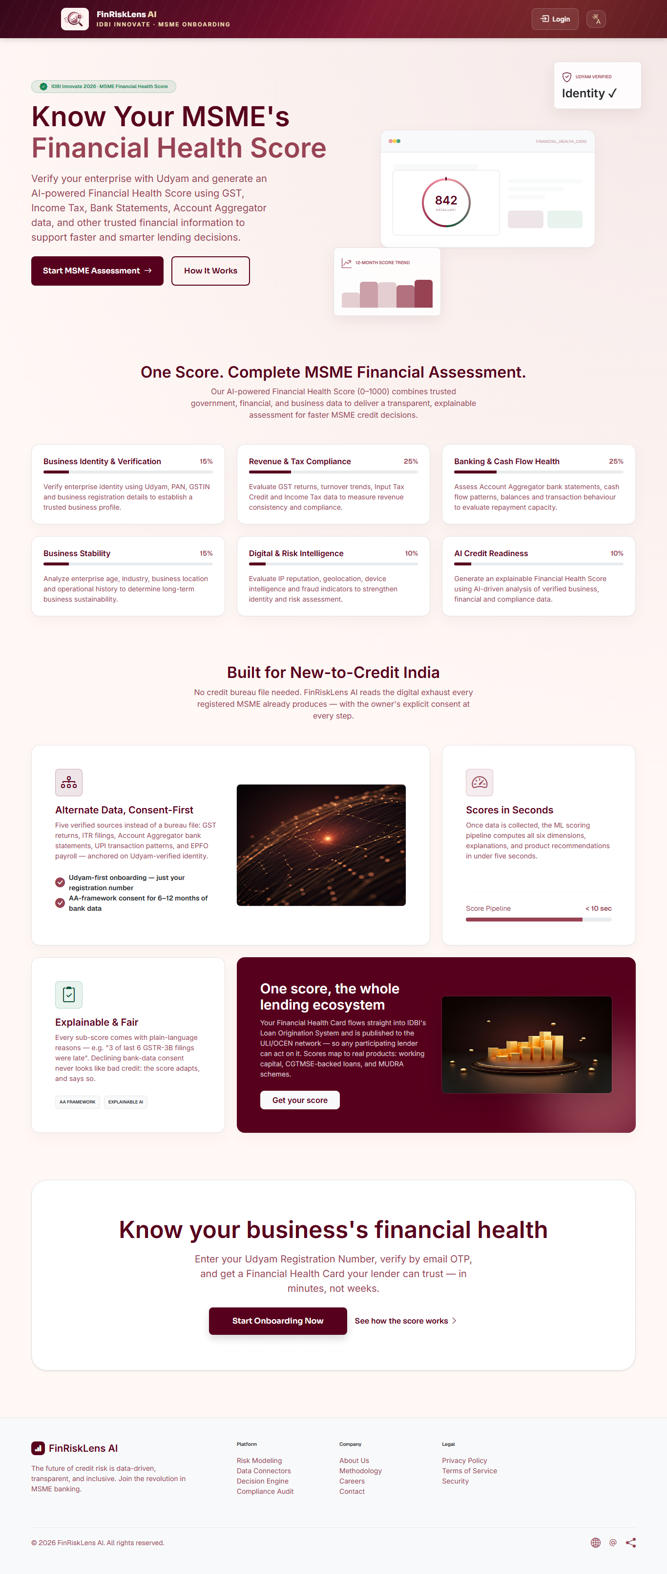
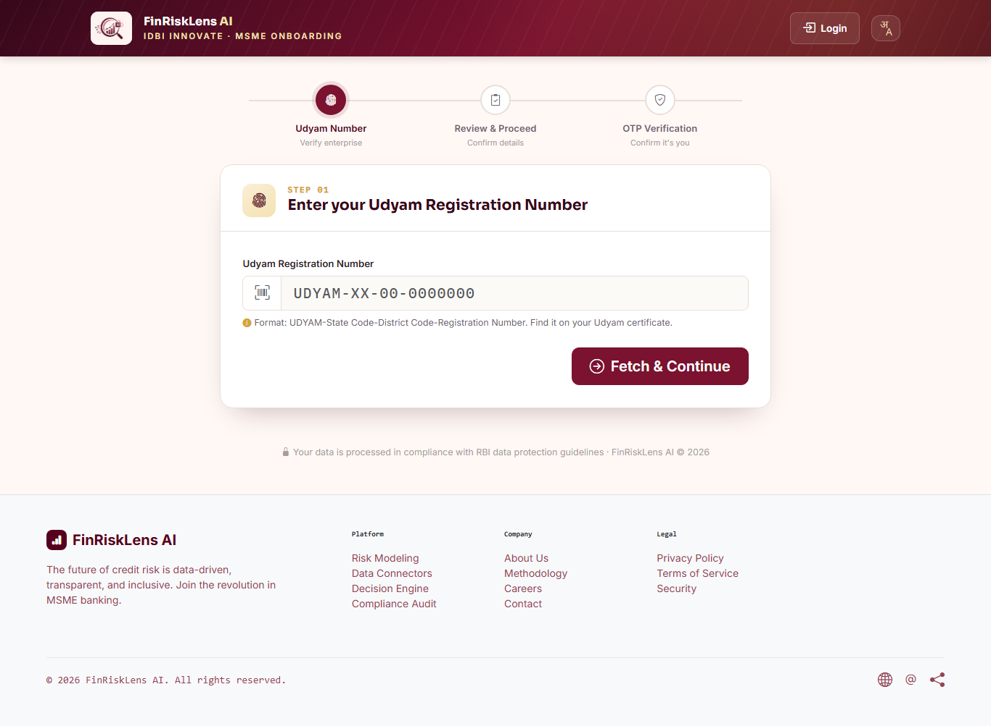
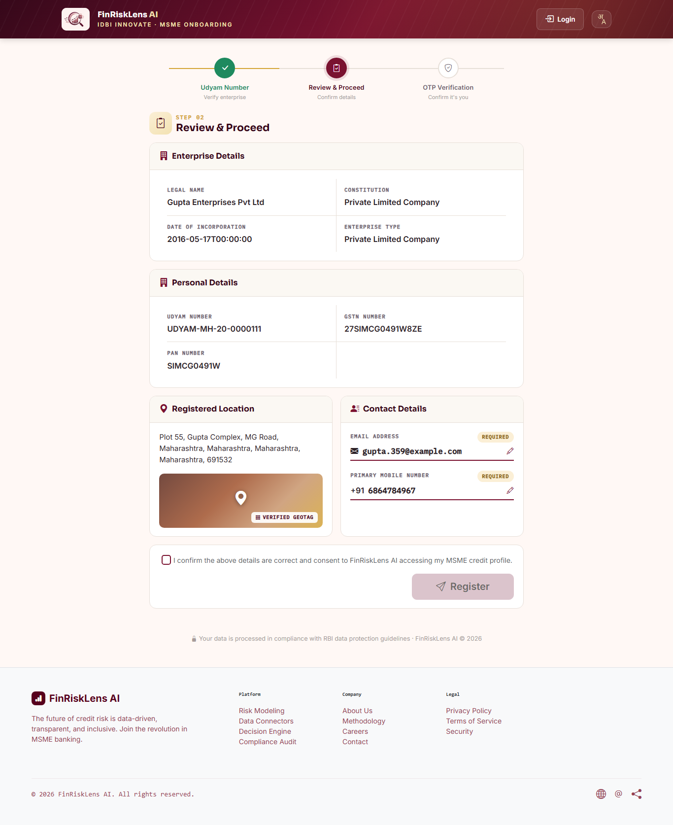
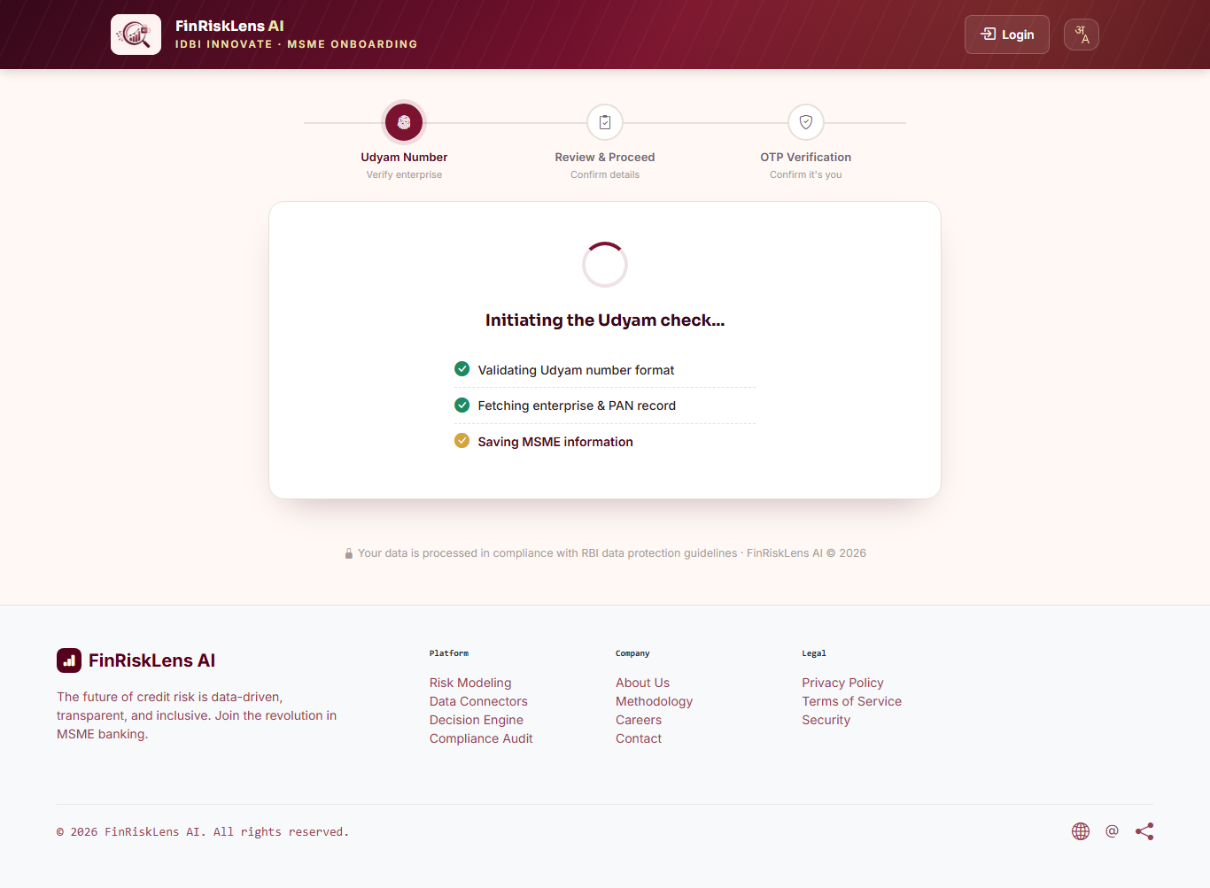
Snapshots of the prototype

Slide 12
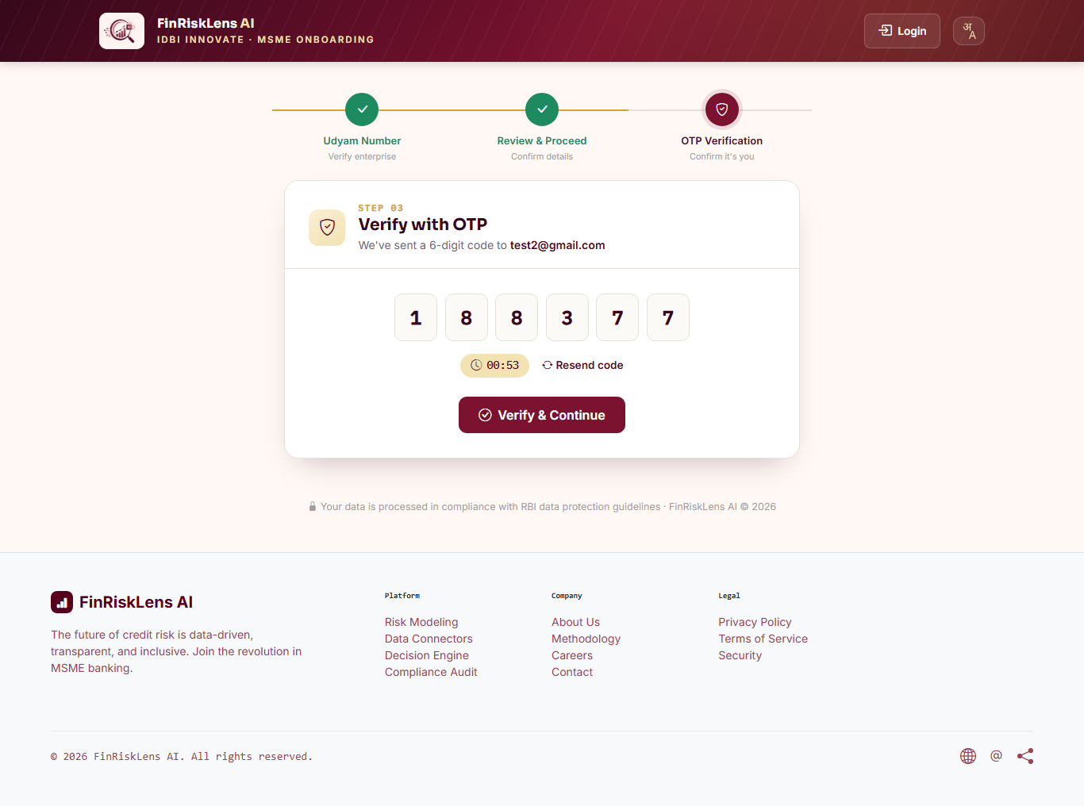
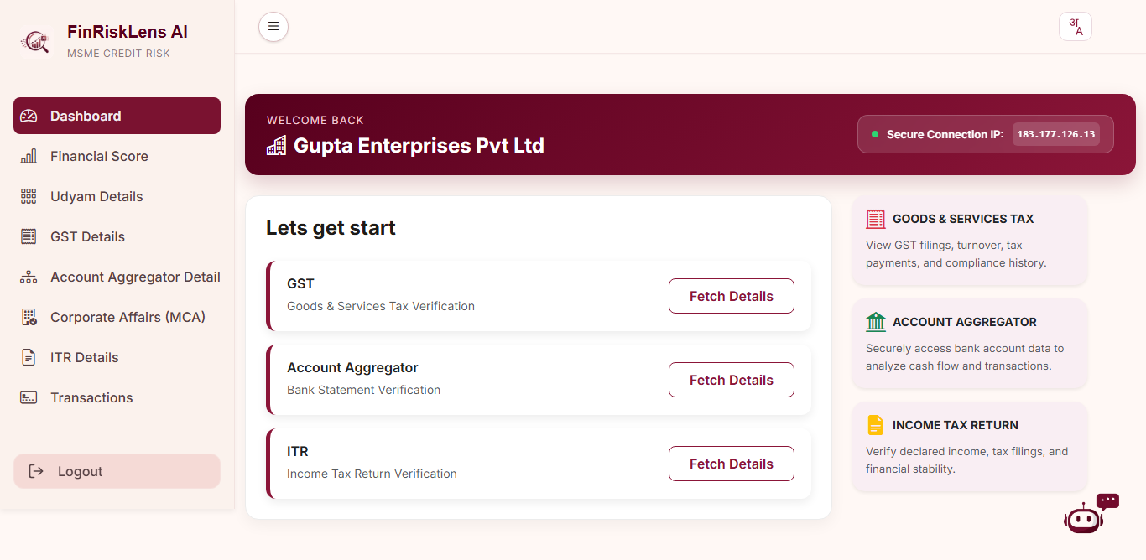
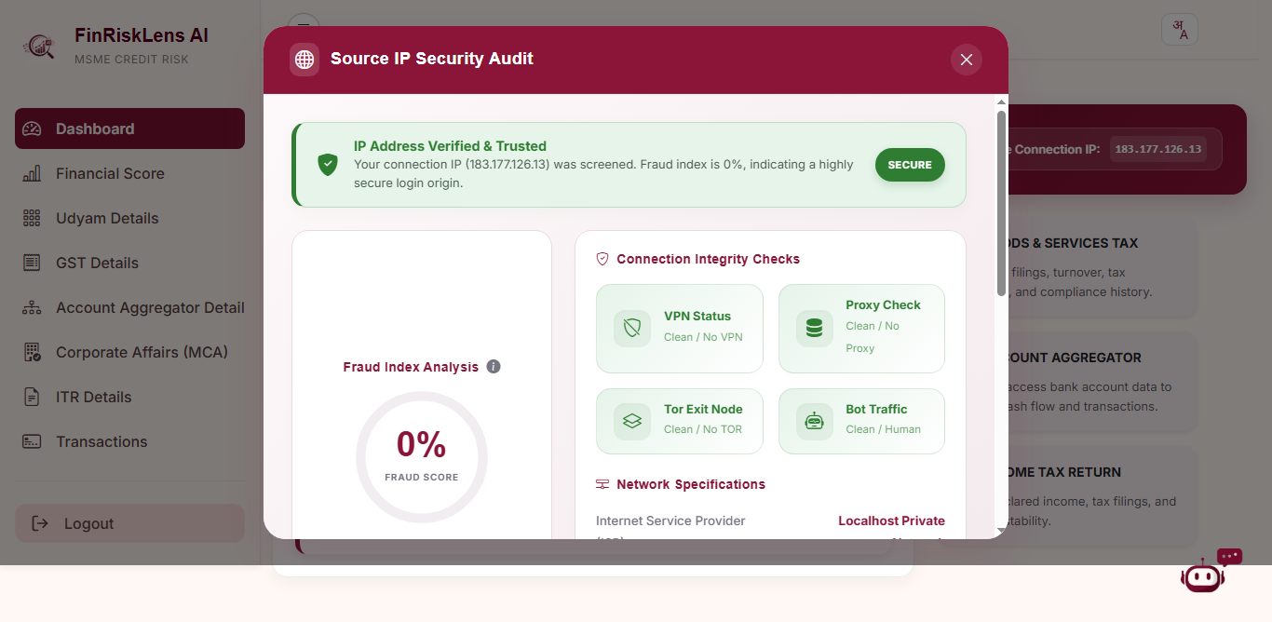
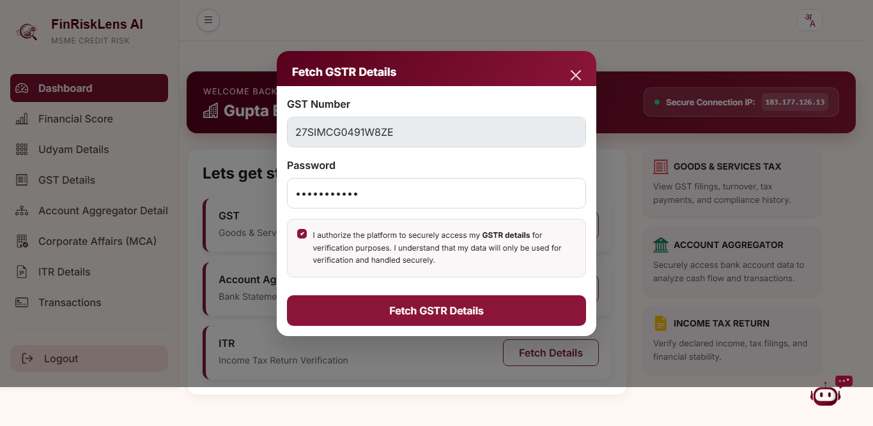
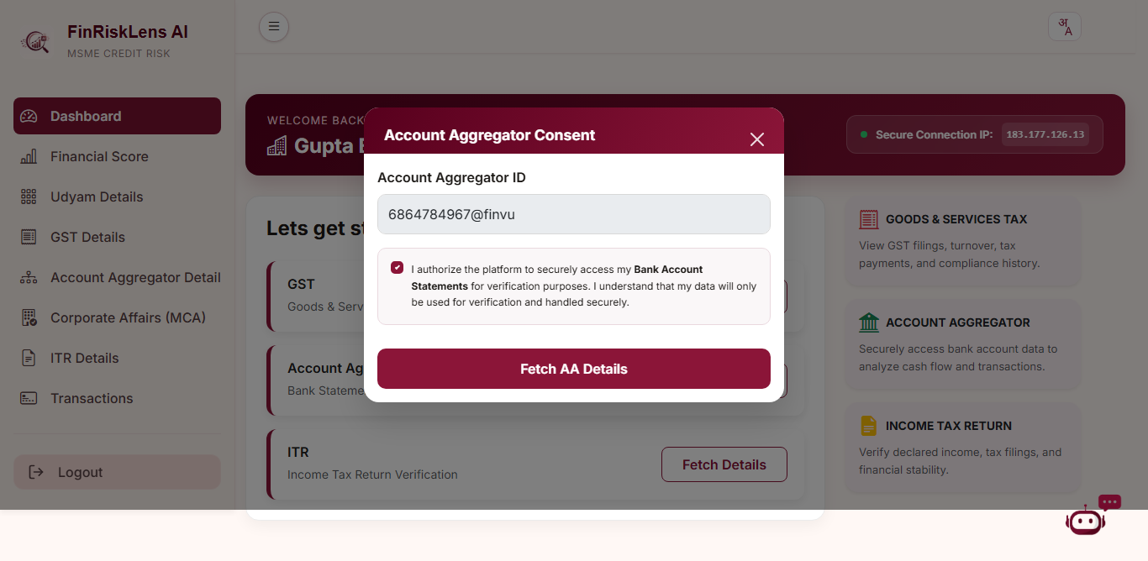
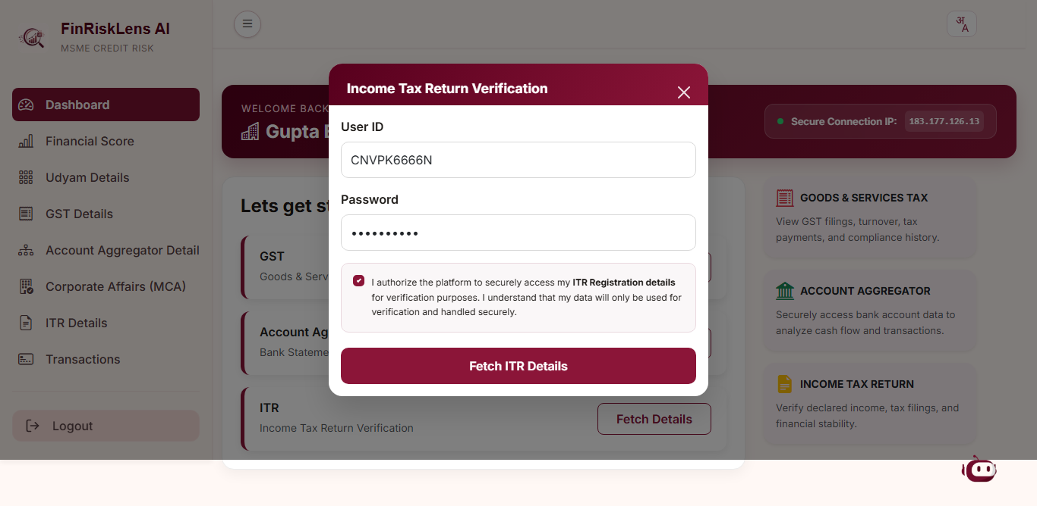
Snapshots of the prototype

Slide 13
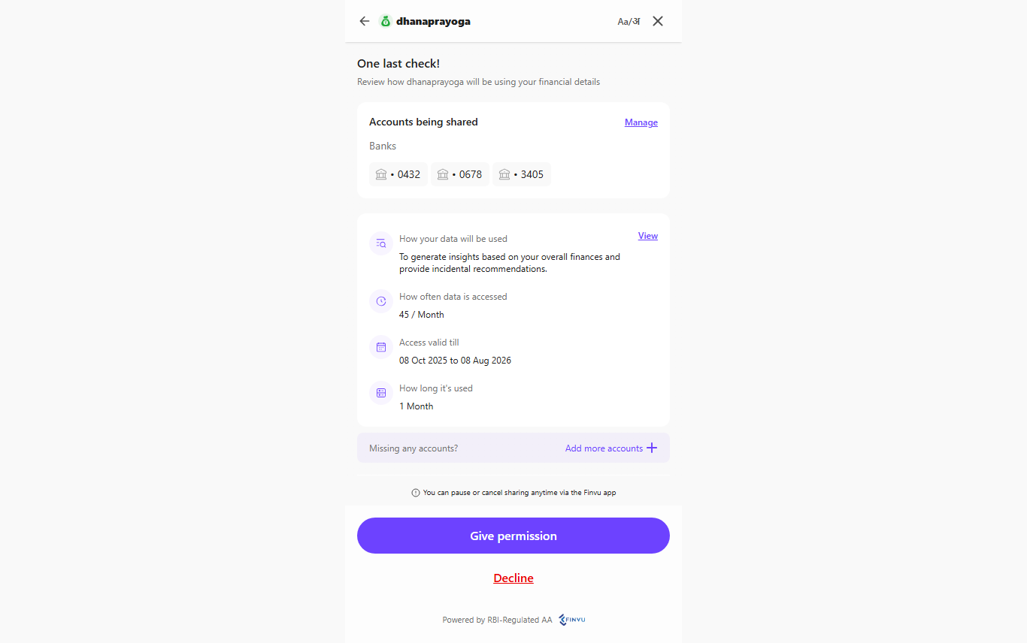
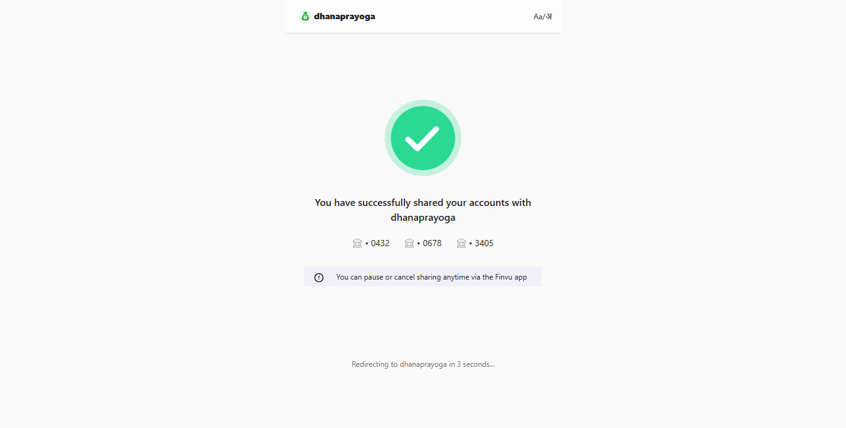
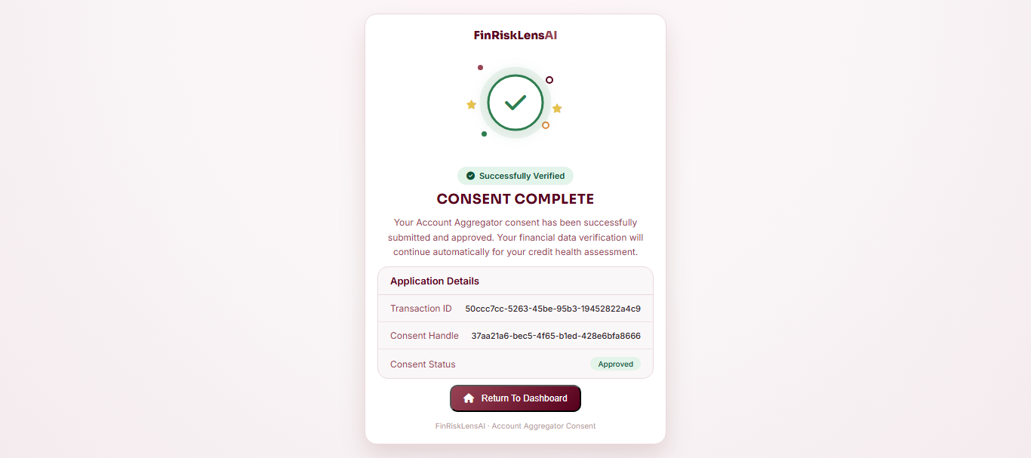
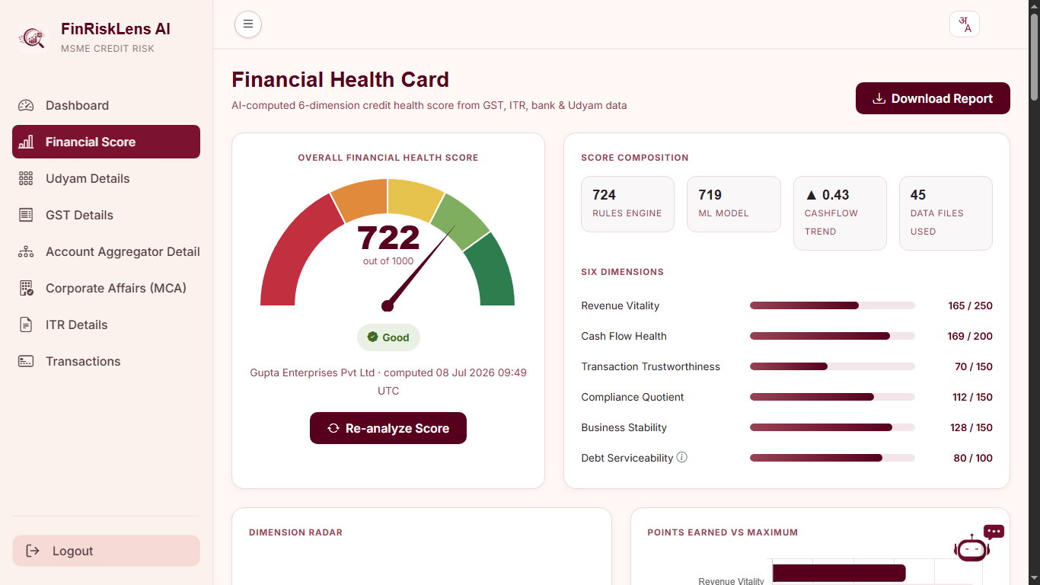
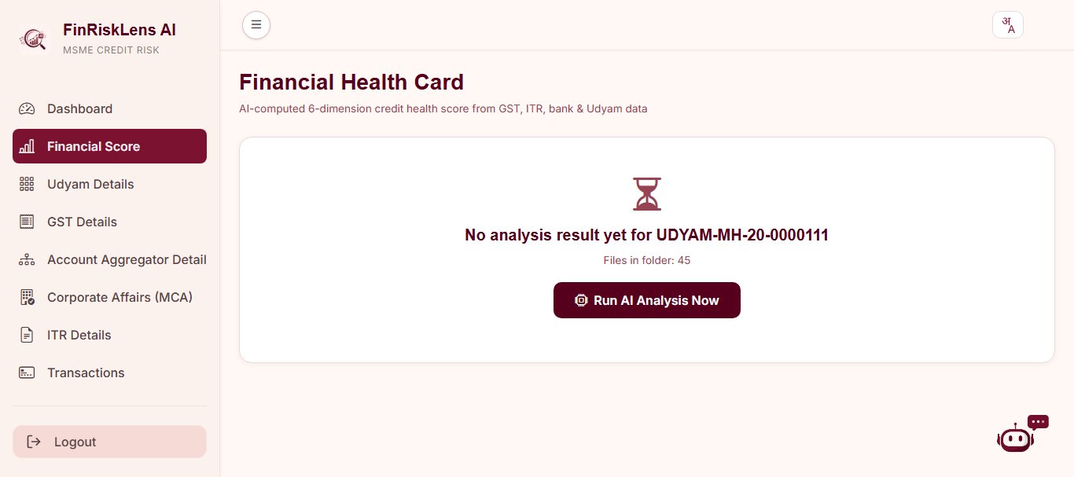
Snapshots of the prototype

Slide 14
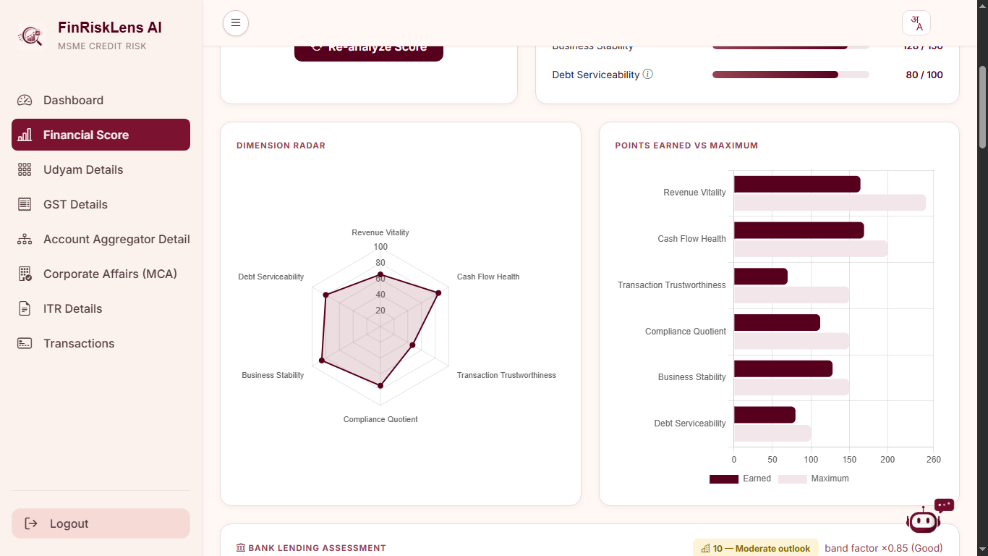
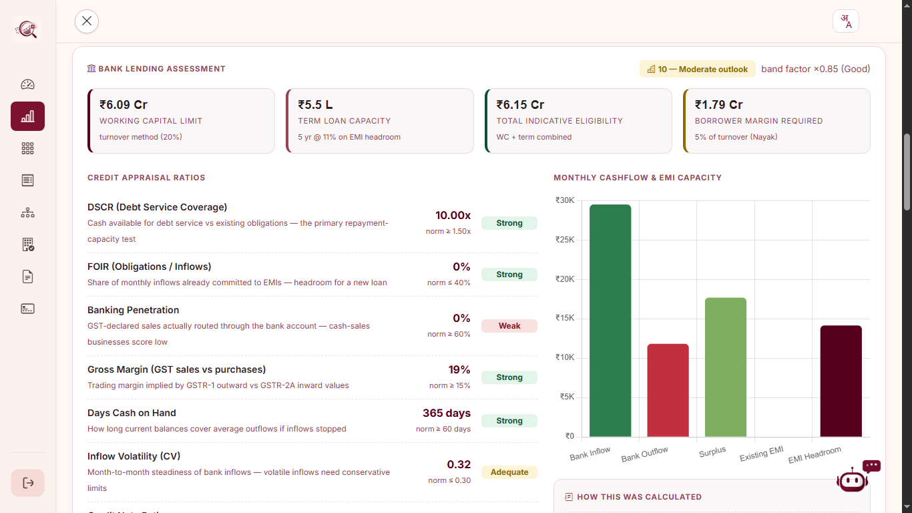
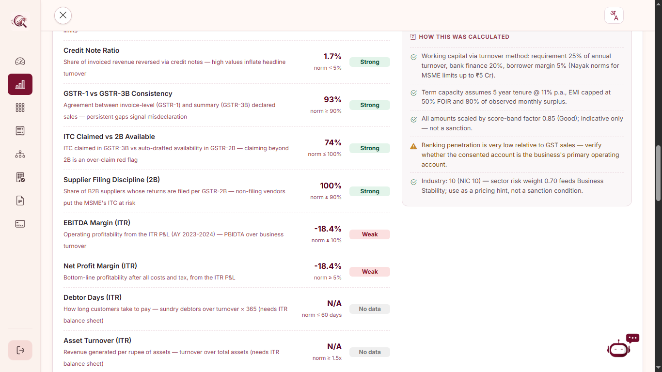
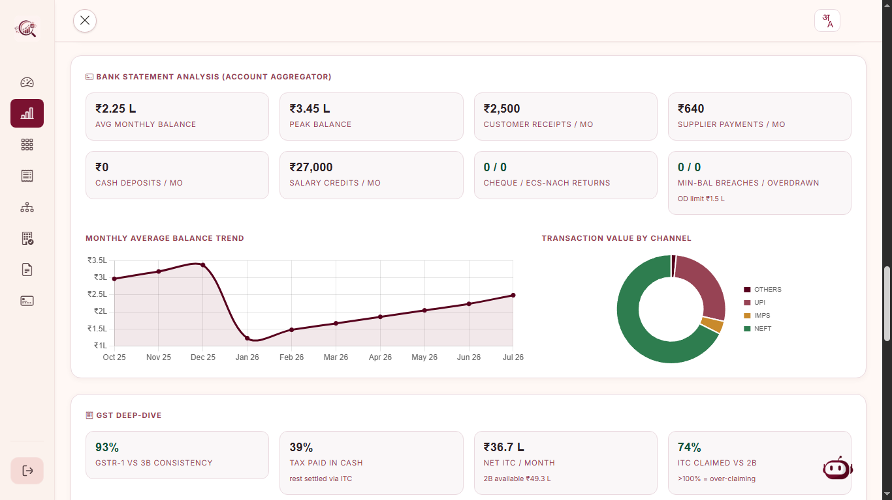
Snapshots of the prototype

Slide 15
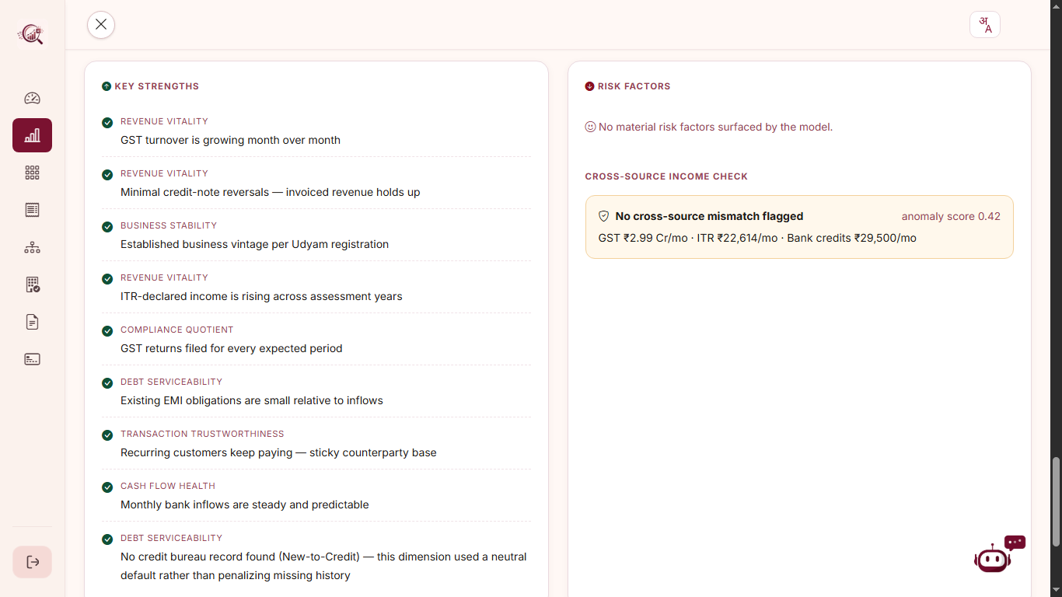
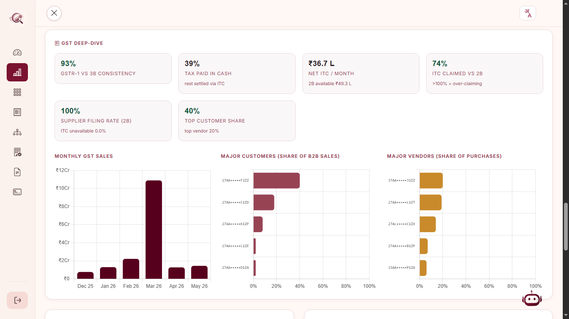
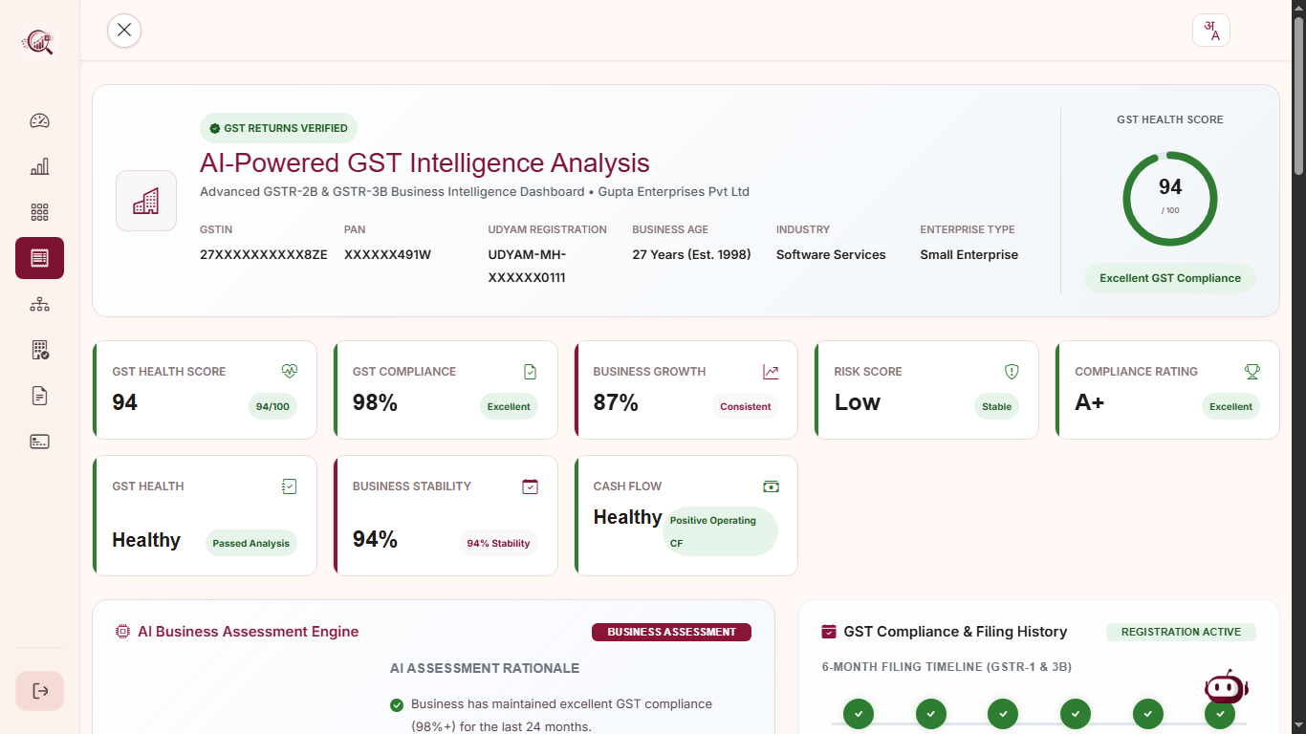
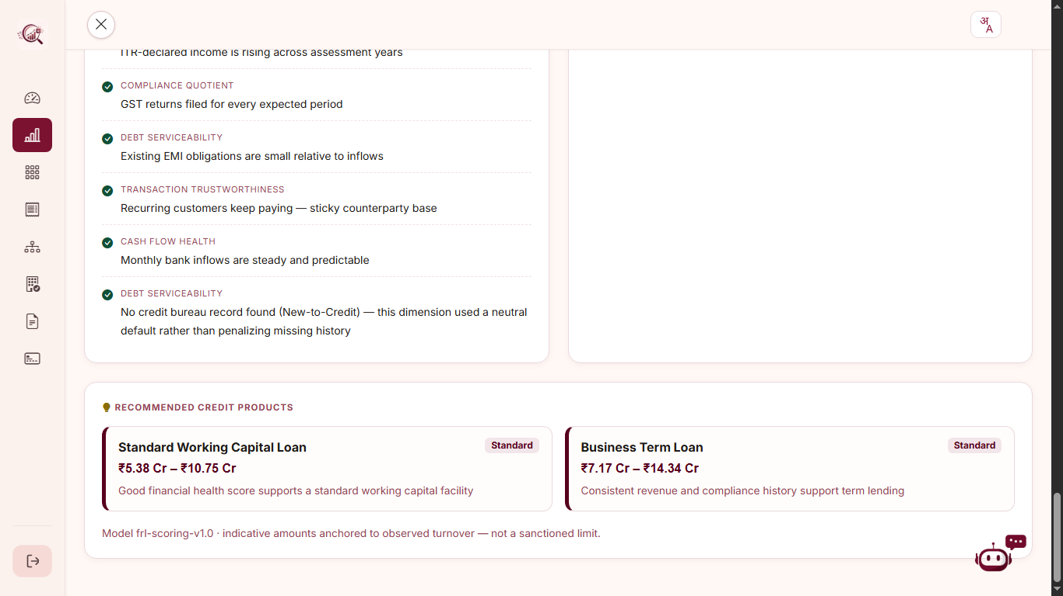
Snapshots of the prototype

Slide 16
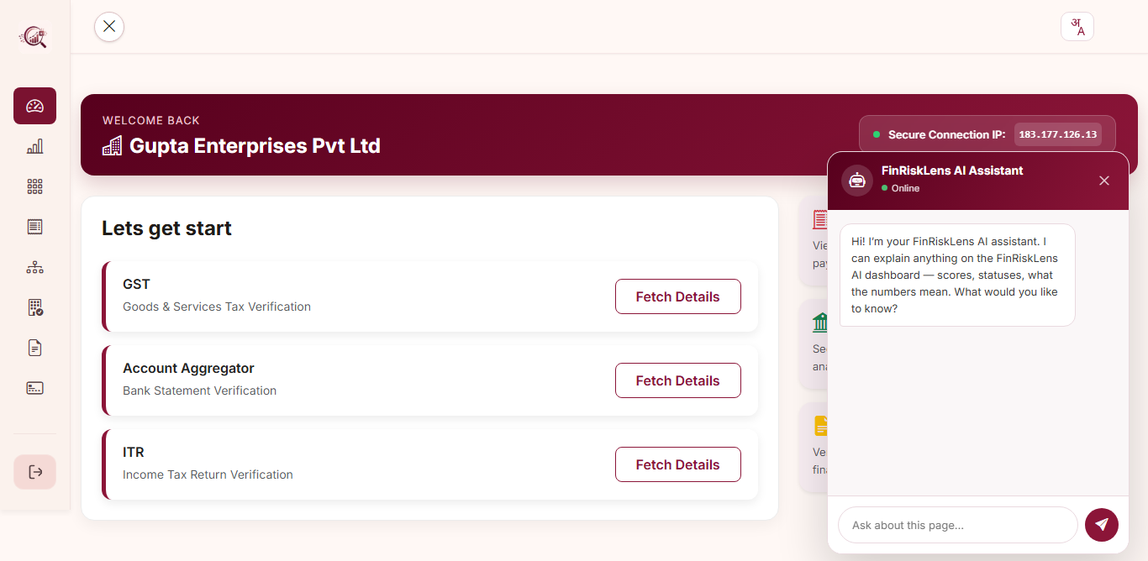
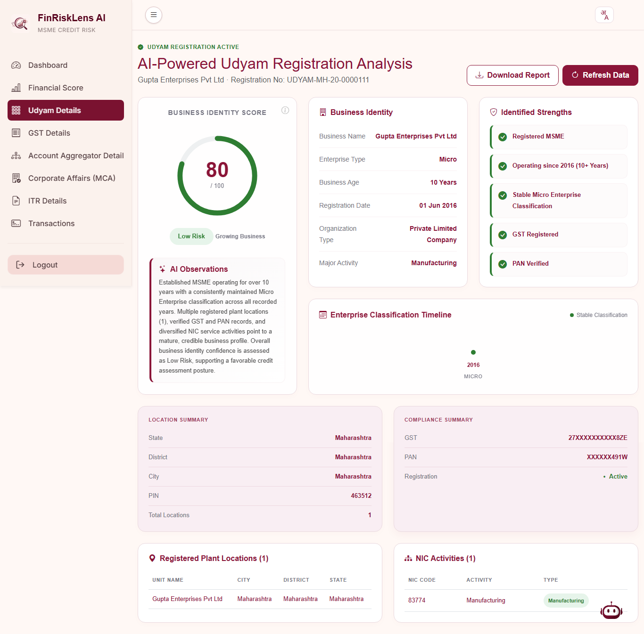
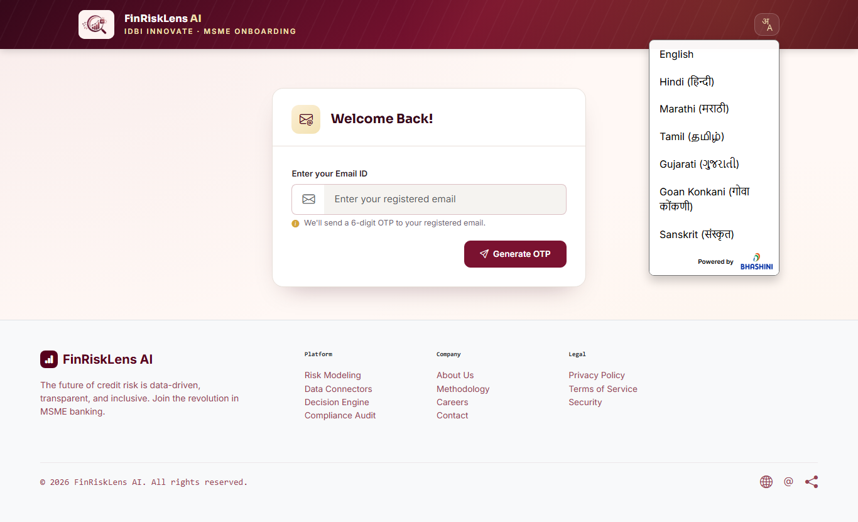
Snapshots of the prototype

Slide 17
Prototype Performance report/Benchmarking
719/1000
Live score on real 6 to 12mo GST data (band: Good)
< 10 s
End-to-end scoring (sub-second when warm)
4
DPI data sources fused: Udyam - GST - ITR – AA (+1 - EPFO)
3000
MSME profiles the model trains on
Benchmark vs. traditional credit assessment
Metric | Traditional / bureau | FinRiskLensAI
Turnaround time | 2-3 weeks (manual) | Seconds (automated)
NTC / NTB borrowers | Rejected - no history | Scored on alternate data
Data sources | 1 - bureau file | 4 - Udyam, GST, ITR, AA (+1 - EPFO)
Explainability | Black-box score | PFI reason per dimension
Fraud / integrity check | None | 3-way GST-ITR-bank anomaly

Slide 18
Additional Details/Future Development (if any)
Deeper Data Integrations
• MCA21 API - company / director & charge-registry checks
• EPFO payroll + GST e-invoice / e-way bill signals
• CERSAI - existing collateral / security-interest lookup
AML, Fraud & Compliance
• Sanctions / PEP / adverse-media name screening
• RBI Central Fraud Registry & wilful-defaulter match
• FIU-IND suspicious-transaction flags on AA data
Lending Ecosystem
• Full ULI DSP + OCEN 2.0 certification & go-live
• CIBIL / CRIF commercial-bureau enrichment (NTB)
• GST-invoice financing & co-lending workflows
Product & Intelligence
• Score trend history + PDF Health Card export
• Portfolio early-warning analytics for IDBI teams
• Vernacular AI assistant + continuous MLOps retraining

Slide 19
Provide links to your:
GitHub Public Repository : https://github.com/abhinavmukwane/FinRiskLensAI
Demo Video Link (3 Minutes):
Final Product Link: https://finrisklensai.com

Slide 21


